Slide 1
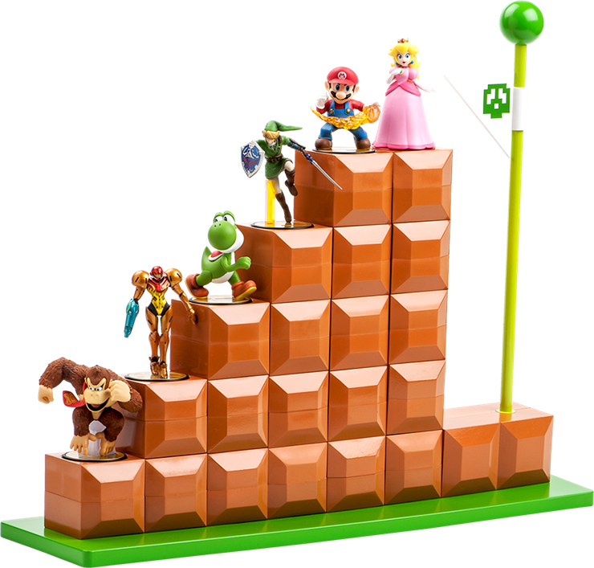
Prof. Victoria McArthur ICCIT @ UTM
CCT 285
Immersive Environment Design
Week 11

Slide 2
What did we do???
Course Overview
This year we explored computer and video games through the design and critique of serious games, specifically looking at procedural rhetoric.
In groups, you identified a topic, genre, and style of serious game, and implemented a working prototype based on your proposals.
Notes:
-Types of serious games:
Newsgames - http://www.epipentycoon.com/
Educational games
Training games
Persuasive games
Political games

Slide 3
Procedural rhetoric
Procedural Rhetoric
The practice of authoring arguments through processes (Bogost, 2010).
In computation, rules of behaviour are authored in code, through the practice of programming.
Through mechanics, video games can mount arguments – they can argue a “thesis” that must be “read” by players.

Slide 4
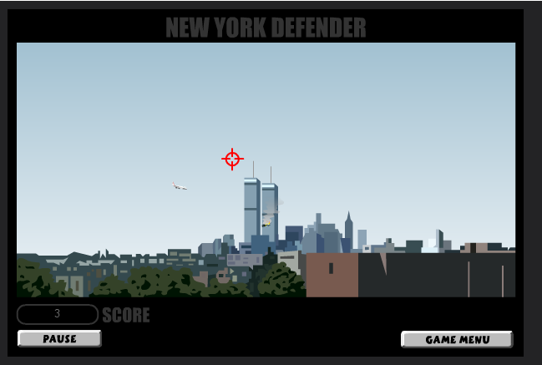
The rhetoric of failure
Procedural Rhetoric
New York Defender
How can we read games that are “unwinnable”?
Bogost argues that September 12th mounts a rhetoric that the situation in the middle east is unwinnable given the tools provided.

Slide 5
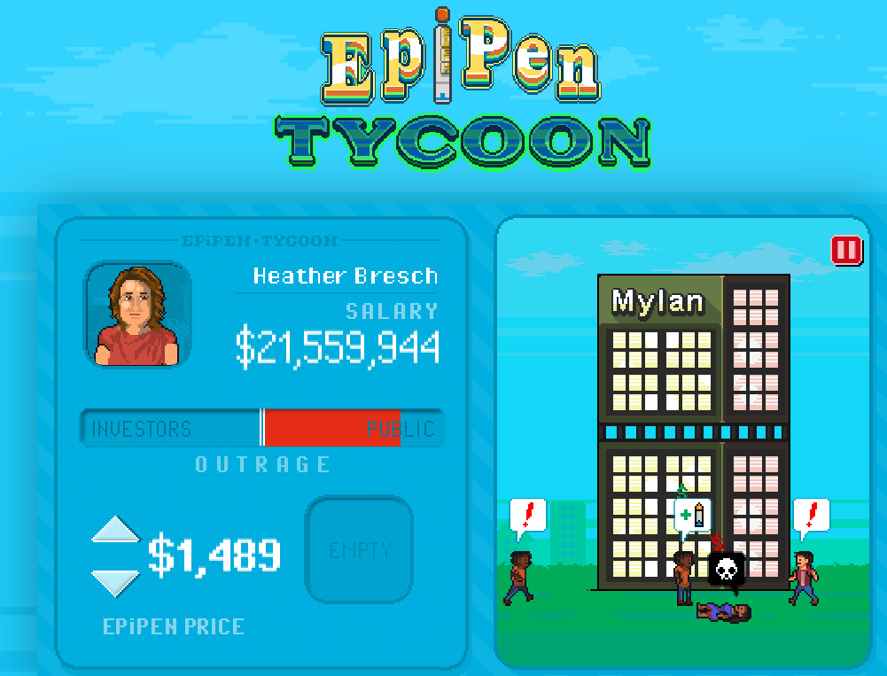
Newsgames
Newsgames
Gonzalo Frasca: “simulation meets political cartoons”
Sicart: games that “utilize the medium with the intention of participating in the public debate”
Newsgames are created in response to a specific current event.

Slide 6
Issues with procedural rhetoric
Newsgames
Unintended messages.
Un-readable (obtuse) messages.
Confusion between literal meanings (via mechanics) and abstract ones (representation).
Confusing awareness with rhetoric.

Slide 7
Edutainment
Edutainment
Edutainment - a type of computer-based instruction designed to motivate the gamer using the characteristics of commercial gaming.
A classic edutainment game is ‘‘Where in the world is Carmen Sandiego?’’
Well-designed educational games seamlessly blend fantasy elements and learning.

Slide 8
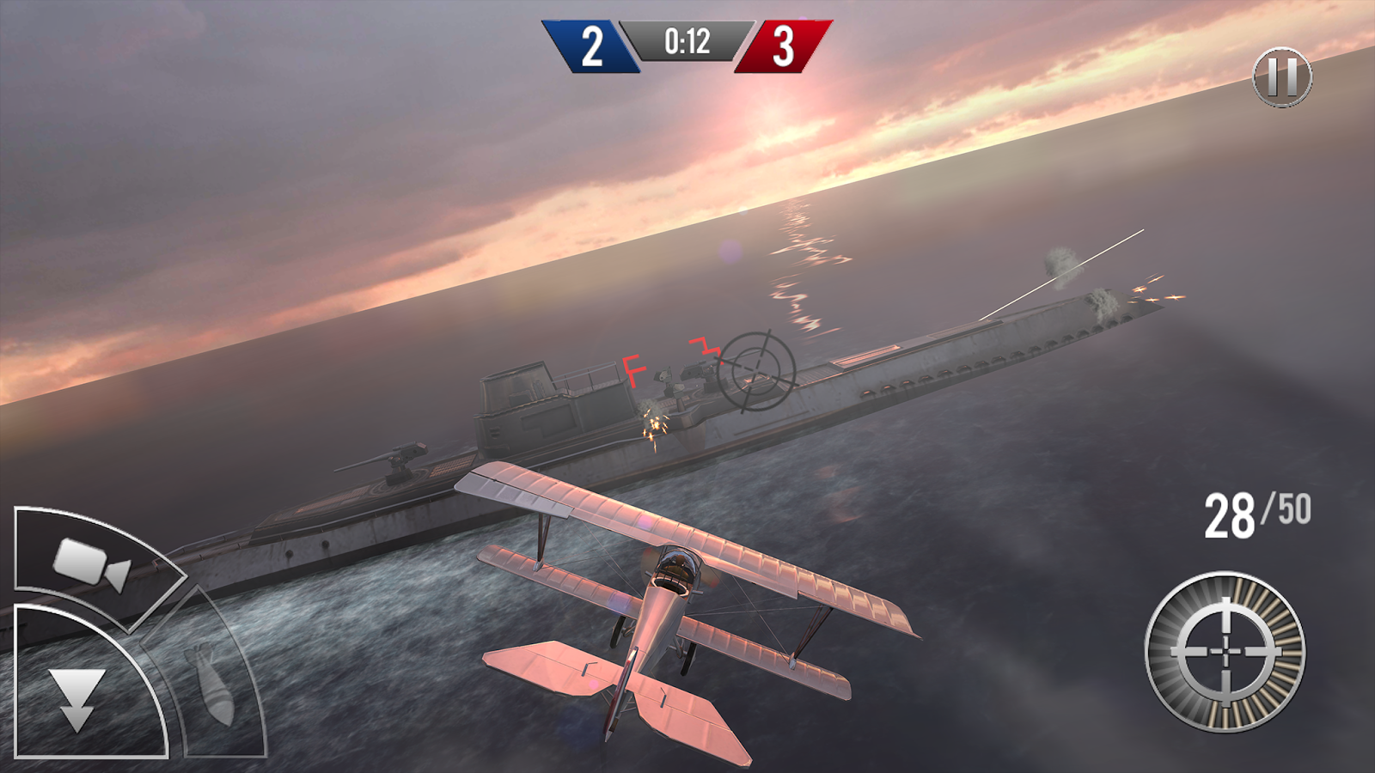
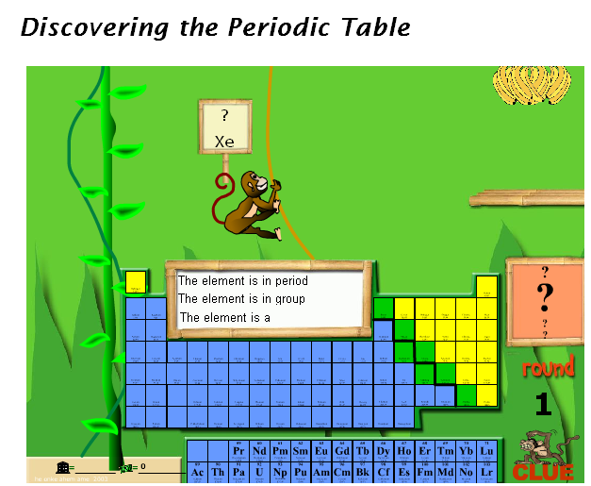
Edutainment
Edutainment
Notes:
We looked at examples of effective learning games, and learning games that forgot to be games...

Slide 9
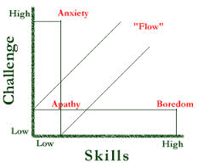
Theories of Design
Theories of Design
Flow Theory (Csikszentmihalyi):
Carefully crafted difficulty levels so game becomes more challenging as player skill increase

Slide 10
Theories of Design
Theories of Design
Meaningful Play (Salen & Zimmerman):
The meaning of an action in a game resides in the relationship between action and outcome.
… occurs when the relationships between actions and outcomes in a game are both discernable and integrated into the larger context of the game.
people
object
meaning
context

Slide 11
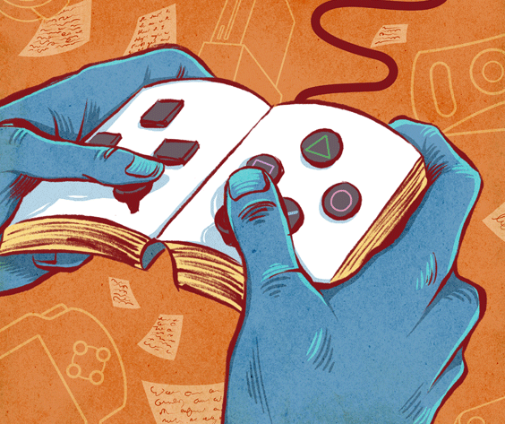
Theories of Design
Theories of Design
Narratology vs. Ludology
Stories are linear, most games are not
Readers are passive, gamers are active
Ludic
Narrative
Notes:
<<left off here, find graphic>>

Slide 12
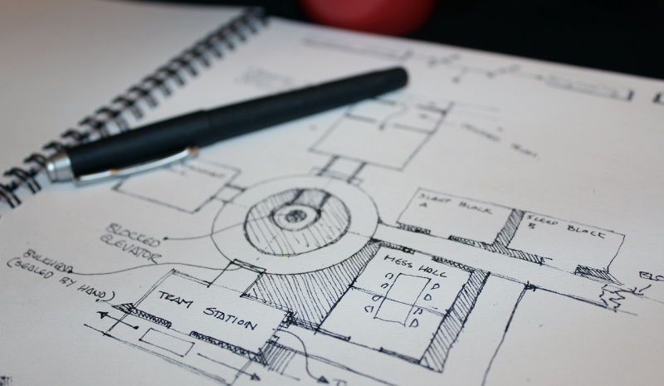
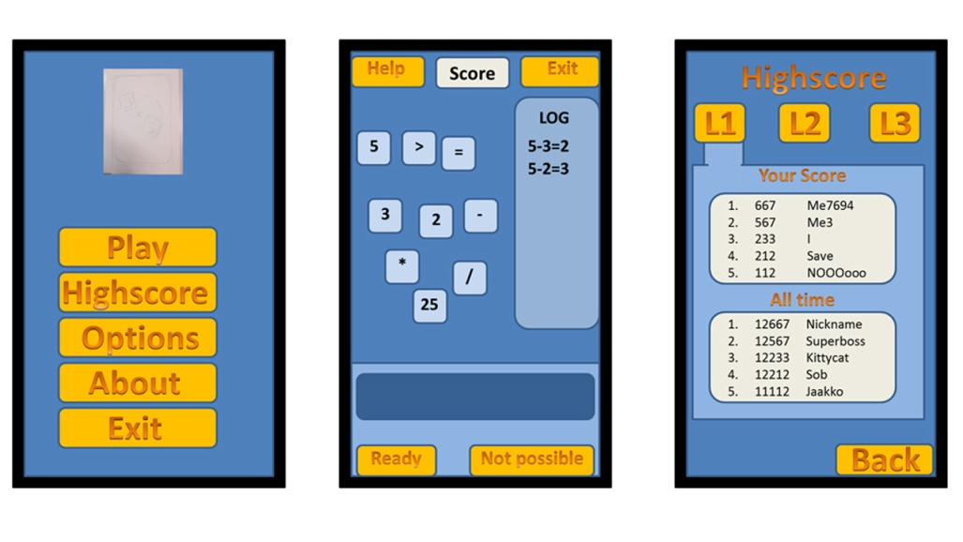
Game Design
Game Design
Genre
Level design
Game mechanics
Character design
Game story
User Interfaces

Slide 13
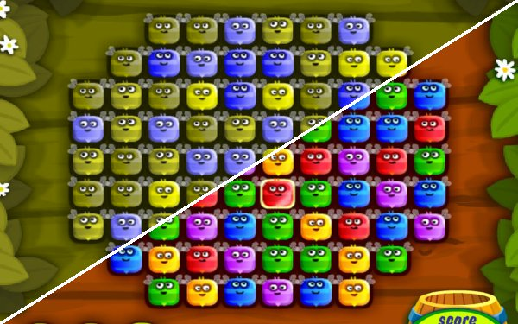
Accessibility Issues
Accessibility
Vision-impaired players
Low vision
Players who need magnification
Colour-blind players
Notes:
In the field of software engineering, standards for designing accessible applications have become standardized and are well-integrated. Unfortunately, the game industry remains far behind in this regard. Early arcade games were designed around the assumption that games were only for players with excellent eyesight and good hand-eye coordination. Accessibility in modern day game design is a must. Here, we will discuss some of the more general categories of impairments and how to address them in game design.
<<can talk about Game Over here – covers all forms of accessibility, including making games accessible for novice players>>
Vision-impaired players – vision impairments fall into several sub-categories that require different adjustments. In any case, you should always provide audio cues to go with any visual cues in your game. Very few events in a video game should ever be silent ones (this is a good practice for general usability).
Low vision – you can help some players with cataracts and similar conditions by providing high-contrast images (in-game objects and UI elements) where possible. Most likely, these players have already turned up the brightness and contrast on their monitors, but your game can augment this further by letting players adjust the contrast in your game. Also, make the textures in your game available for modification. Vision-impaired players can then edit your textures to meet their own needs.
Magnification - some players with vision-impairments need everything to be a bit larger to see properly. You can meet the needs of these players in 3 ways: first, allow players to change the font size of in-game text. Second, support multiple monitor resolutions in your game (some players might need to set the resolution to 640x480). Finally, you can provide a magnifying glass feature that players can move around over the screen to magnify different areas.
Colour-blind players – colour blindness is a sex-linked genetic disorder primarily affecting men (affects about 6% of men). People who are colour-blind have reduced sensitivity to different shades of green – they appear more like yellow. This issue matters most in UI design. (image: composited screen shot of Honey Bee Match 3 – top half is rendered in green colour-blind mode – this game is unplayable for people with this condition). You can test your artwork at the vischeck website vischeck.com

Slide 14
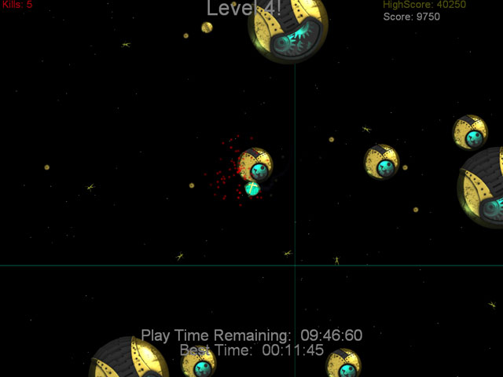
Accessibility Issues (Cont.)
Accessibility
Hearing-impaired players
Visible cues for audible events
Separate volume controls
Optional rumble feature
Closed captioning
Mobility impairments
Notes:
Hearing-impaired players – to help support hearing-impaired players, consider the following:
Display visible cues for audible events. (If a car scrapes along a rail, show sparks; when a gun fires, show a muzzle flash, etc.)
Offer two separate volume controls, one for music and one for sound effects. Allow the player to mute either one entirely. Hearing-impaired people (remember, hearing-impaired does not mean deaf in all cases) find it difficult to focus on foreground sounds while simultaneously filtering out background ones.
Use the rumble (vibration) feature of the controller if the controller includes one. If you do this, players will be able to feel events even if they cannot hear them. Also allow the player to turn off vibration – not all players like it.
Supply optional subtitles for dialogue and sound effects (a.k.a. closed captioning).
Mobility impairments – the best thing you can do for players with mobility impairments is to reduce the time pressure required to accomplish tasks. Many people with physical impairments can manage with enough time, but they don’t always get the time they need. If it is feasible, include a switch that lets the player adjust the speed of the game. There is no such thing as “too slow.”
Also consider keeping your controls simple. Strange Attractors (shown above), one of the finalists at the Independent Game Festival in 2006 (created for Retro Remakes “One Switch Competition”). Everything in the game is controlled by a single button. In Strange Attractors, this single button toggles in the influence of gravity between the player’s ship and everything else.

Slide 15
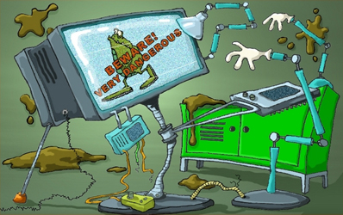

Slide 16
Group Presentations
Group Presentations
In class December 5th
Game demo
Post-mortem of design process
Post-mortem: performed at conclusion of a project, used to analyze & reflect upon elements of the project that were successful/unsuccessful
Shortened to 10 minutes
Rubric available on the learning portal (under Course Materials).
Notes:
Groups will be asked to present their game and a post-mortem of the design process in the final class. Presentations should be approximately 15 minutes in length and should provide a detailed overview of the game itself, the research process, as well as any design considerations resulting from iterative prototyping. Issues encountered during the design and development, as well as how they were overcome should also be addressed. Students should be prepared to demo their prototypes to the class as well as a broader audience (e.g. other faculty, students, etc.).

Slide 17
Rubric Overview
Group Presentations
Game demo:
game functions
demo runs smoothly
demo is integrated well with presentation

Slide 18
Rubric Overview
Group Presentations
Summary of theories that guided the design:
evidence that game design is informed by theories and frameworks discussed
theories/frameworks are accurately described by group members
Notes:
Talk about theories here more – reflect on persuasive, news, & educational
-talk a bit about design theories here (e.g., character design, interface, etc.)
-groups should consider a 60/40 split for theory/design

Slide 19
Rubric Overview
Group Presentations
Quality of the group’s reflection on the design process:
evidence that game design was reflective process, not triage

Slide 20
Rubric Overview
Group Presentations
Duration of the presentation:
10 minutes long
time is used effectively
brief introduction of team
6 minutes for gameplay*, including:
2 minutes to discuss game narrative/core mechanics/goals
4 minutes to introduce theory & relate back to game
3 minutes to reflect on design
1 minute for discussion/conclusions
*make sure your game is loaded before presentation starts!
Notes:
**offer a suggested breakdown of the presentation (it’s 10 minutes, not including questions/interaction)
-brief introduction of team
-6 minutes for gameplay? (make sure game is loaded before this), including:
-2 minutes to discuss game narrative/core mechanics/goals
-4 minutes to introduce theory & relate back to game
-3 minutes to reflect on design
-1 minutes for discussion/conclusions

Slide 21
Rubric Overview
Group Presentations
Group preparedness
Group representation
Group ability to engage audience
Group’s response to questions
Group’s overall presentation style
Notes:
1 Group preparedness
-presentation is well rehearsed
2 Group representation
-all group members participate in the presentation relatively equally
3 Group ability to engage audience
-good energy and expression
-group has planned meaningful interaction with audience (not just "what do you think?" style questions)
4 Group's response to questions
-group reflects on questions (listening to understand, not listening to respond)
-responses clearly reflect intention to address questions
5 Group's overall presentation style
-professionalism, etc.

Slide 22
Presentation Suggestions
Group Presentations
Make sure the team is presented (including roles)
Play the game and talk through game play (rehearse this!)
One projector = media limitations!
Check tech compatibility well in advance!
Notes:
-make sure the team is presented (including roles)
-play the game and talk through game play (rehearse this!)
-only one projector, so keep in mind that switching between powerpoint & a game is awkard (think back to how many times I’ve had to fumble with settings to get things to work when switching between games & ppt during lecture)
-make sure (in advance) that your tech will work here (can you run the game from your laptop? Does your laptop plug in here? Are you planning on using the PC here?)

